Slide 1
Cross Border Strategy
Thought pieces

Slide 2
Focus Areas (sub-streams?)
Addressing – Arunjay Katakam, UNCDF
Messaging – Michael Richards, Infitx
Settlement – Julie Guetta, Partior
Compliance – Paul Makin, Mojaloop Foundation
Notes:
No dispute about

Slide 3

ACCOUNT ADDRESSING USING PROXIES
9 MARCH 2023

Slide 4
Why can’t we send money the same way as we send an email?

Slide 5
Imagine if each email you sent had a different pricing structure to it depending on who you were writing to, and that costs go higher the poorer your recipient is.

Slide 6
Send money to anyone, anywhere just like you can call, message or email

Slide 7
WHAT IF WE DO NOTHING (need a better title)
CURRENT INDUSTRY EFFORTS:
IMPACT OF DOING NOTHING
G20 Roadmap for Enhancing Cross-border Payments, building block 16: Establish unique identifiers with proxy registries deprioritized in February 2023
Private sector pursuing disparate efforts, but not interoperable
No bank-centric solution on the horizon
Adoption of digital payments remains a challenge, especially for inclusion
Transferring funds remains cumbersome and difficult
Women are impacted more than men*
Study: Moving beyond access to design: the relevance of the Level One Principles for the gender DFS gap

Slide 8
ACCOUNT ADDRESSING
The directory of Proxy directories will:
Connect participating Proxy directories
Return validation of Proxy and the Legal Entity Identifier of recipients PSP
Work on zero-knowledge proof
Proxy Addressing System Service (PASS)
Notes:
Interoperable directory of Proxy directories to exchange and resolve Proxies
• Enhanced user experience for all ecosystem participants
• Flexibility to use any directory’s supported Proxy in a standardized way
• Assurance to the sender that the payee/recipient is valid and ready to receive funds
• Ability of the sender’s PSP to receive information on the payment system(s) supported by
the recipient’s PSP, so it can select the preferred payment system to route the transaction
to the recipient

Slide 9
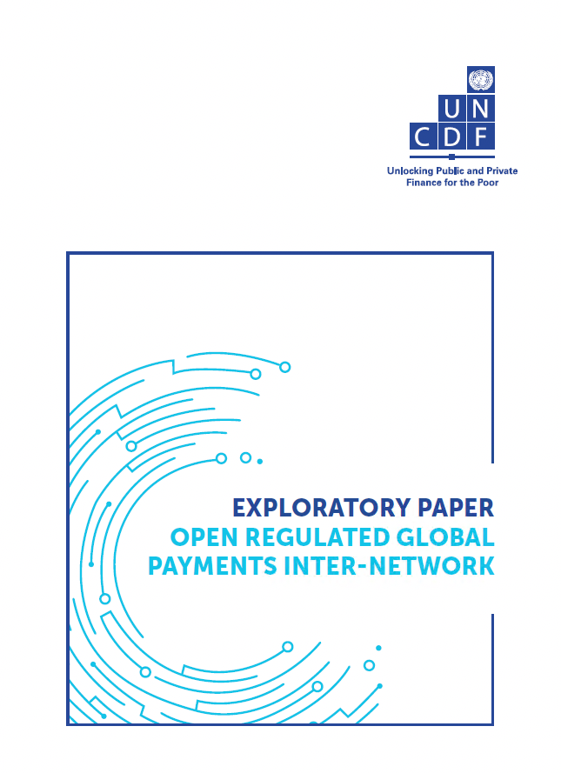
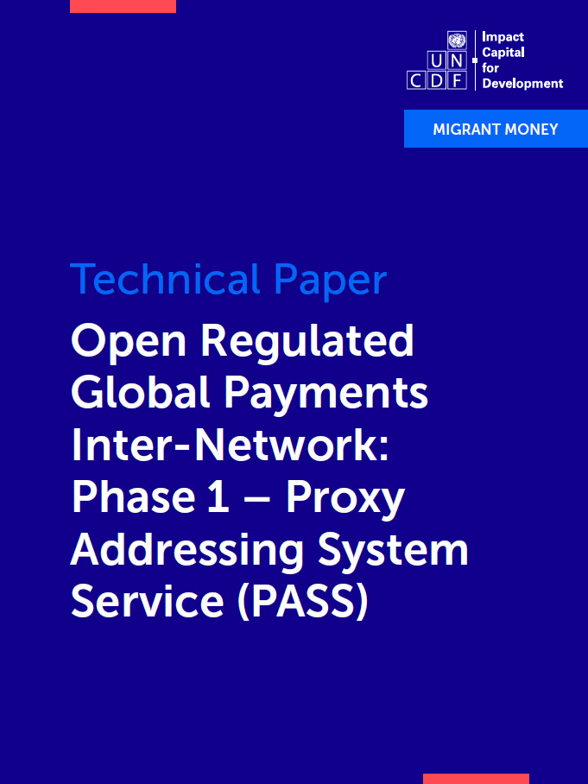
MORE INFORMATION

Slide 10
SUMMARY
1. Speed up total interoperability
2. Allow users to use an easy to remember proxy alias
3. Increase adoption of digital payments

Slide 11
Messaging between payments systems
Michael Richards

Slide 12
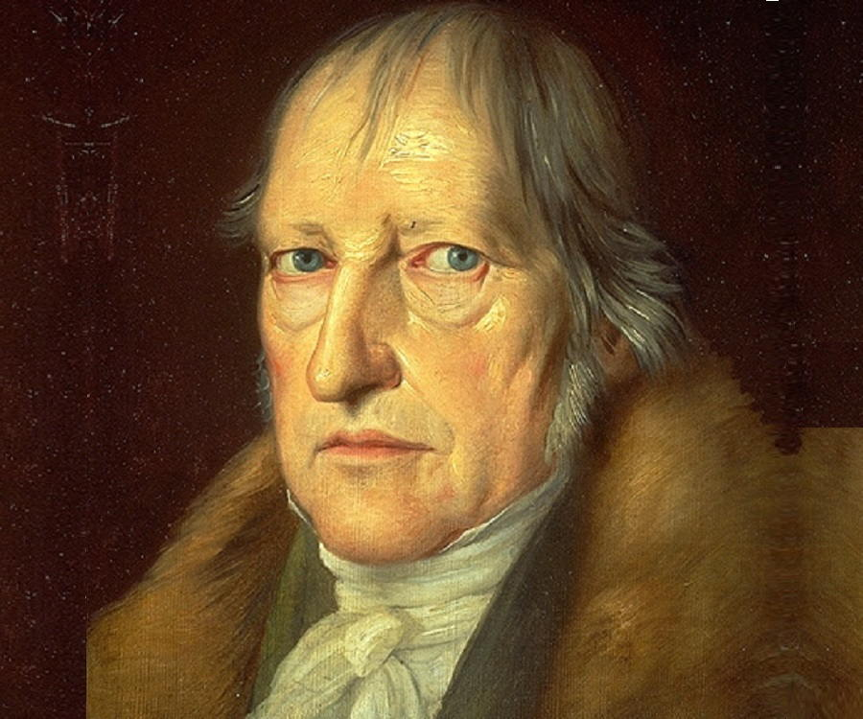
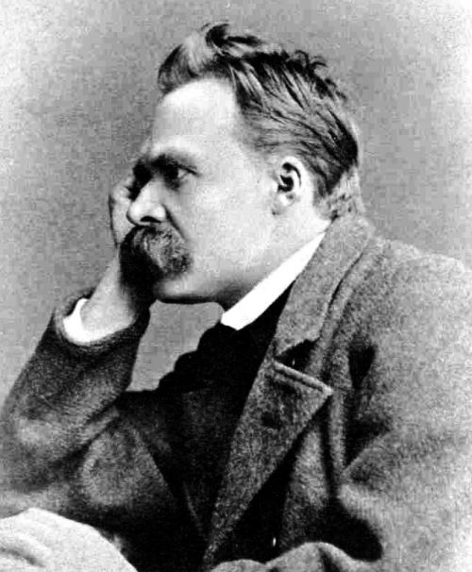


If payment systems were philosophers…
Notes:
What do these philosophers have in common? They wrote in German, they’re white, they’re men… But mostly: the believed that philosophy was a single thing which was the same for all people, for all communities, for all time.

Slide 13

If payment systems were philosophers…
Notes:
This is Emmanuel Eze. He started to think about an African philosophy, which he saw as an example of a philosophy of a particular community or society. That wouldn’t make it less rigorous, but it would mean that it wouldn’t need to pretend to universality

Slide 14
Problem Statement
Message definition proceeds from the ground up:
Message definitions solve local interaction problems…
…and expand in response to evolving local needs
But it works from the top down:
A message definition is a way of formalising payment relationships
Payment practice must “conform” to message structure
Which leads to nonconformist adaptations to local needs
Every message structure is meaningful in a specific payment context.
Using a message definition means participating in a payment system
And that means: participating as an individual institution…
… which can belong to more than one payment system.

Slide 15
Problem Statement
Every message definition exists in a tension between private needs and public conformity
Adopting the inclusive approach (e.g. ISO 20022) merely displaces the expression of local needs to market practice definitions.
Adopting the local approach (Nexus) means that financial institutions need to belong to different payment systems, and hence use different messages.

Slide 16

What if we do nothing?
The market will continue to converge on message content which is:
Determined by the ability of individual account-holding institutions to connect to multiple interop systems.
Hence: defined by economic power…
… and restricted by the capacity of individual institutions to buy a seat at the table
What’s missing here?
The question of interconnection between systems rather than institutions…
… which can extend interconnection to institutions of any type and size…
… by allowing intermediate interop systems to bear some of the interconnection burden

Slide 17
What approach are we recommending?
Interconnection between systems, not institutions
Context extension by translation, not abstraction
Solve the hierarchical specialisation problem of increasingly abstract definitions by transforming it into a conversion problem

Slide 18
What’s the problem with connecting schemes?
(Apart from settlement, that is…)
Non-repudiability
There is a simple and well-understood method of connecting heterogeneous messaging systems:
The cross network provider (aka Payment Manager)
But it destroys end-to-end non-repudiability by making the CNP sign the converted message…
… based on the assumption that the CNP will be the liquidity provider
This is the same assumption that Nexus makes

Slide 19
Is there an alternative?
To retain end-to-end non-repudiability across schemes we would need:
A reliable way for an FI to obtain the public key of any reachable FI
A way to convert message content across schemes
Secured by a standard test suite executable by any participant
A reliable way to obtain the content of a received message in a standard format
AKA a canonicalisation service
Also secured by a test suite executable by any participant

Slide 20
How might this work?
Please canonicalize this ISO 20022:
Pacs.008:
Please canoncicalise this GSMA:
message
Sender FI:
TIPS/EcoBank
Canonicalisation service
Receiver FI
ISO
GSMA
There you go
There you go
Canonical message
CNP
ISO 20022:
Pacs.008: execute payment
GSMA:
POST /transactions/type/transfer
Public key
Public key service
Please give me the public key for TIPS/Ecobank
Cross-system non-repudiability check
There you go

Slide 21
Settlement Challenges
Name

Slide 22
Problem Statement
Cross-border payments are still too costly, not transparently enough, too slow and with too limited access, resulting to high fees for the consumers and often lack of customer protection
Actually the cost of processing cross-border payments is quite high, hence generally the high fees charged being charged to the customers
The banks need to maintain relationships with other banks
The banks need to have access to liquidity to settle transactions, which can be very tricky particularly for illiquid currencies
The banks need to protect themselves against settlement risk
Notes:
No dispute about

Slide 23
What if we do nothing
If we don’t change how transactions are settled:
Consequence 1: Break on the G20 quantitative KPIs published (Probably: High/Impact: High)
With the extracting methodology leveraged by banks to settle cross-border payments, it will be a real challenge for banks to limit the cost of cross-border payments
Consequence 2: Potential increase of fragmentation (Probably: High/Impact: High)
To achieve the G20 quantitative KPIs, banks may only focus on commercially viable corridors
Consequence 3: Increased systemic risks as usage of alternative rails, and particularly non-sovereign currencies ramp up (Probably: High/Impact: High)
Example: crypto rails which are less regulated with:
Increase financial stability risk as providers are less regulated
Increase risks for the customers who seriously lack customer protection when they use these rails.
Now that the revised FSB roadmap has been re-focused on policy alignment and interoperability, itis all the more so critical for us to tackle the settlement challenges.

Slide 24
What approach are we recommending
Understand how settlement can be done differently across different jurisdictions
Option 1: Working on reginal CBDC
Option 2: Integrating a settlement layer within Mojaloop and test a regional settlement with a pre-funded scheme, leveraging e-payments rails
Option 3: Accelerate integration with regional projects that include a settlement layer
Option 4: Investigate how Mojaloop can be used as a bridge between omnibus accounts
Hypotheses we would like to prove
Settlement can be done with fewer intermediaries so that the cost and risks are reduced
Settlement can be done with limited involvement of a settlement bank

Slide 25
Cross Border Strategy
The Challenges of Compliance

Slide 26
Problem Statement
Cross Border Transactions are the most challenging in terms of regulatory compliance; technically, it’s easy(ish), if you can get over the question of trust, but regulatory challenges have killed many nascent services
The FATF Recommendations provide a framework, focussed on AML, CFT, CPF
With derived recommendations around CDD, transaction monitoring
Banks have over-reacted to FATF; FATF have rowed back, but too late, and anyway those multi-billion $ fines confirm the banks’ suspicions

Slide 27
What if we do nothing
Recent recommendations to “ease” international finance do nothing for the world’s underserved
“Trust” is between regulators, who “vouch for” their regulated entities – the banks
Mobile wallets, MFIs are on the outside; (sometimes) supported, but at a price

Slide 28
What approach are we recommending
Develop a trust framework that extends to NBFIs
Mojaloop can already manage this from the technical, transactional perspective, but needs to be extended
Carry evidence of CDD compliance with/derived from the transaction
To include evidence that the NBFI is itself compliant
Compliance goes way, way beyond mere CDD compliance; need to develop an understanding of this in the NBFI community, and the financial community needs to provide them with the tools to demonstrate they comply
Work with regulatory authorities to validate this approach

